Slide 1

Operators

Slide 2
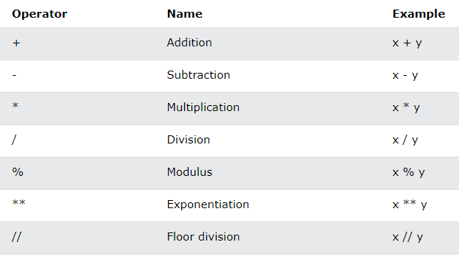
Arithmetic Operators

Slide 3
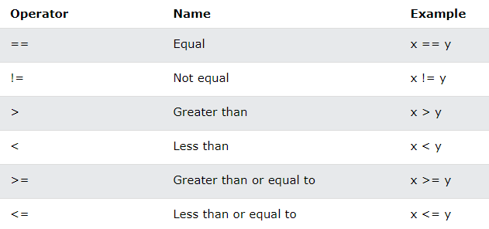
Comparison Operators

Slide 4

Logical Operators

Slide 5
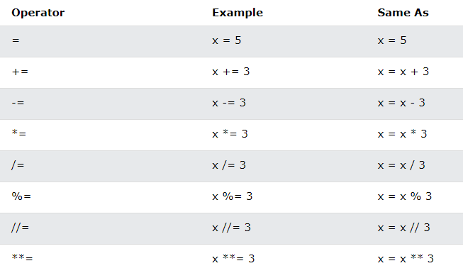
Assignment Operators

Slide 6
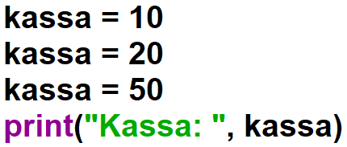

Assignment Operators

Slide 7
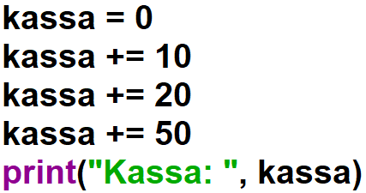

Assignment Operators

Slide 8
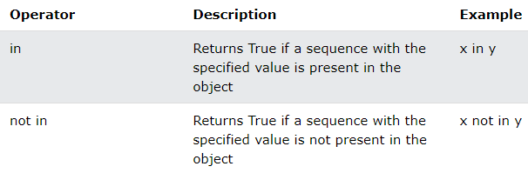
Membership Operators

Slide 9

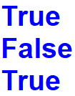
Membership Operators

Slide 10

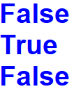
Membership Operators

Slide 11


Membership Operators

Slide 12


